Slide 1
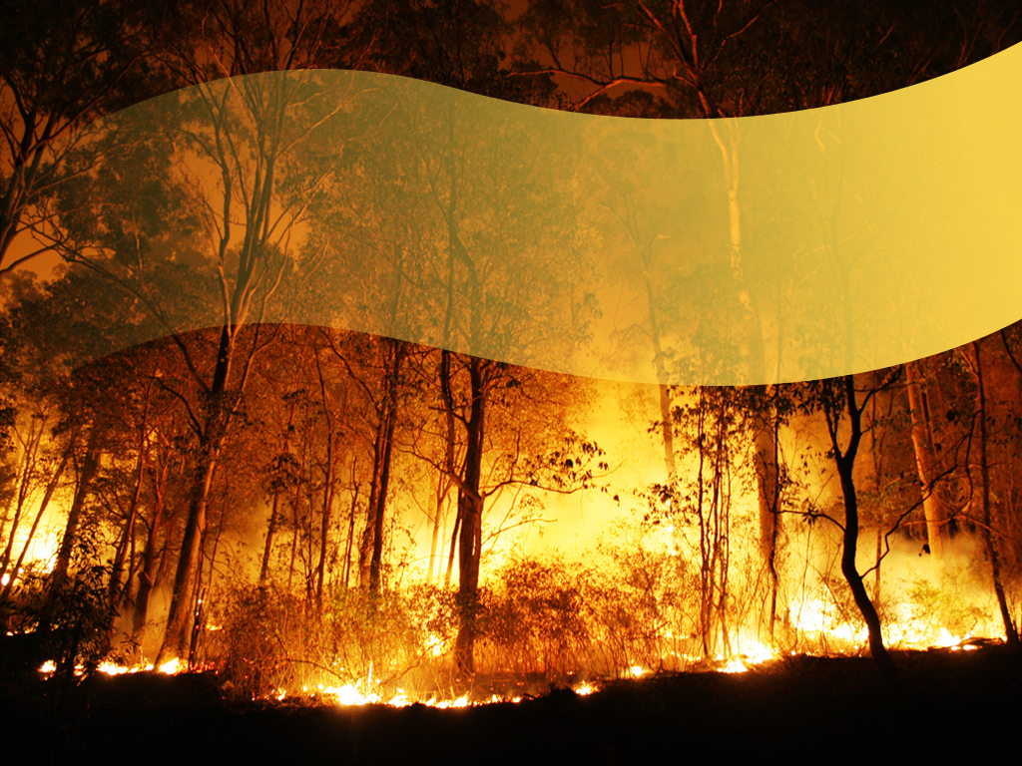
FOREST WILDFIRES IN CANADA

Slide 2
In light of recent devastating wildfires such as those in British Columbia (2023) and Alberta (2019), it's imperative to understand the nature & causes of wildfires and their impact on the environment using data between 1946 and 2021.

Slide 3


Research Questions
What causes forest fires and does changes in environmental weather conditions (i.e. Temperature & Humidity) affect it?
How has the frequency and spatial distribution of wildfires in Canada changed overtime?
Does forest fire impact water quality?

Slide 4
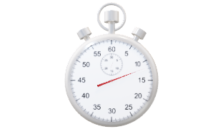
Research Questions
What causes forest fires and does changes in environmental weather conditions (i.e. Temperature & Humidity) affect it?
How has the frequency and spatial distribution of wildfires in Canada changed overtime?
Does forest fire impact water quality?

Slide 5

Research Questions
What causes forest fires and does changes in environmental weather conditions (i.e. Temperature & Humidity) affect it?
How has the frequency and spatial distribution of wildfires in Canada changed overtime?
Does forest fire impact water quality?

Slide 6
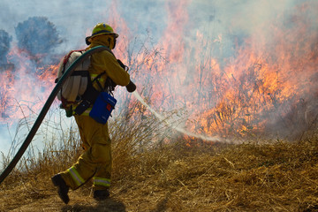
Stakeholders
Our findings are poised to benefit a wide array of stakeholders, all seeking effective forest fire prevention and mitigation strategies.
They include:
Government agencies (i.e. CFS, CIFFC, NRCan)
Environmental organizations
Climate change researchers
Policymakers
Insurance companies
Forestry Companies
Indigenous communities
General public

Slide 7
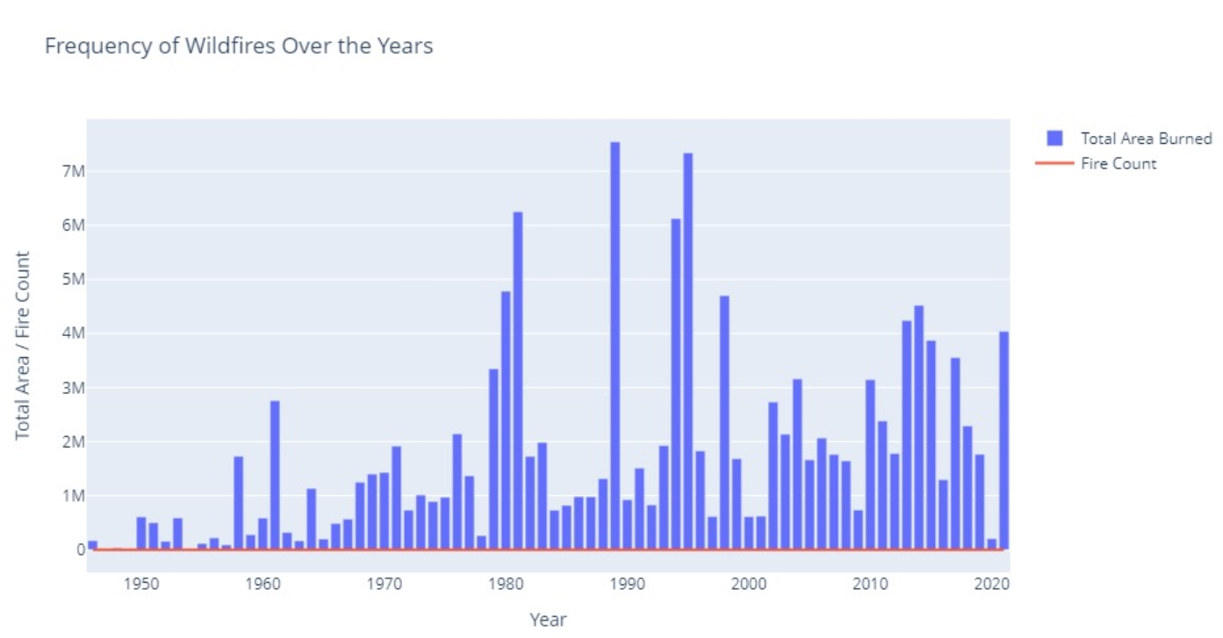
An average of 2.5 million Square kilometer of land are consumed in Canada annually.
Noteworthy years include 1989, with 7.5 million square kilometers burned and a fire count of 770, and 1995, with 7.3 million square kilometers burned and 439 fires. In contrast, the lowest total area burned was in 1955, with only 44 counts of fires, indicating a relatively mild wildfire year.

Slide 8
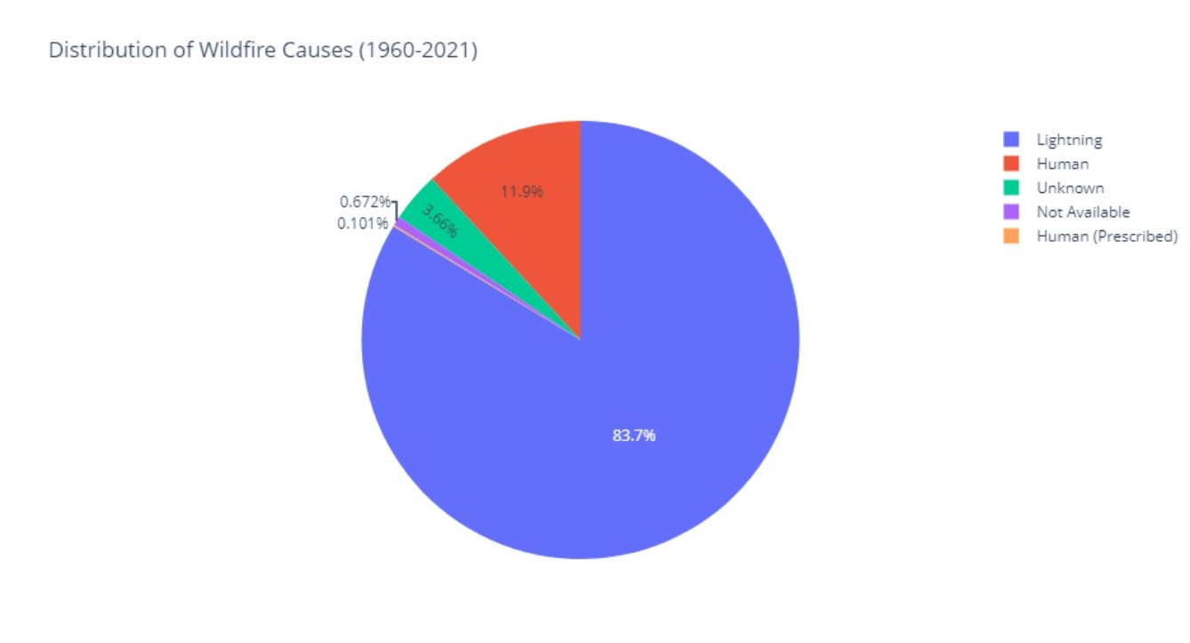
Lightening is the biggest cause of wildfire
84% of all forest wildfires in Canada result from natural causes in the form of lightning strikes
12% start from human activities, including Campfires, Fireworks, Power lines & Arson
The remaining 4% is still undetermined

Slide 9
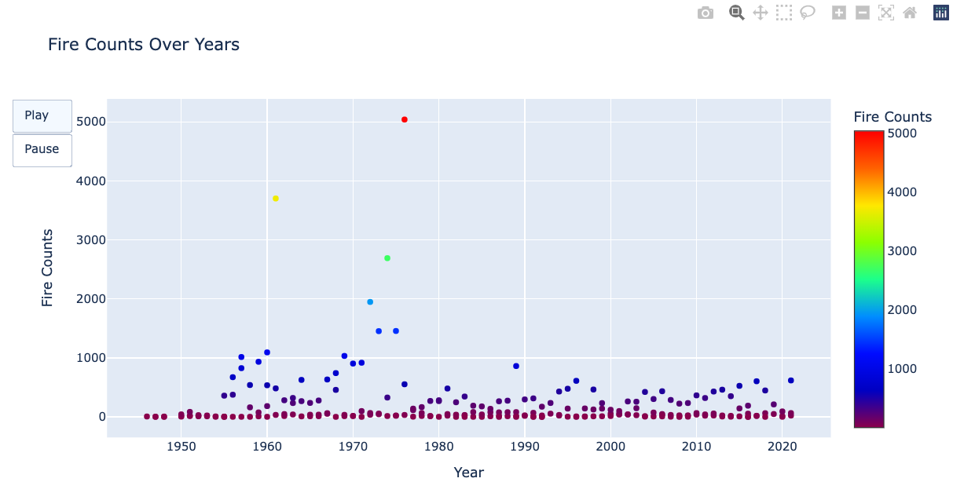
WILDFIRE COUNTS
Seasonal patterns in fire counts exhibit fluctuations, with heightened activity often observed during dry seasons like summer.
The animated scatter plot effectively visualizes the temporal dynamics of fire occurrences, allowing for easy identification of trends and peaks.
Notably, in 1976, the summer season recorded the highest fire counts of 5039, indicating a significant spike in fire activity during that year.
These insights empower stakeholders to implement proactive measures, fostering sustainable environmental management and mitigating the impact of wildfires.

Slide 10
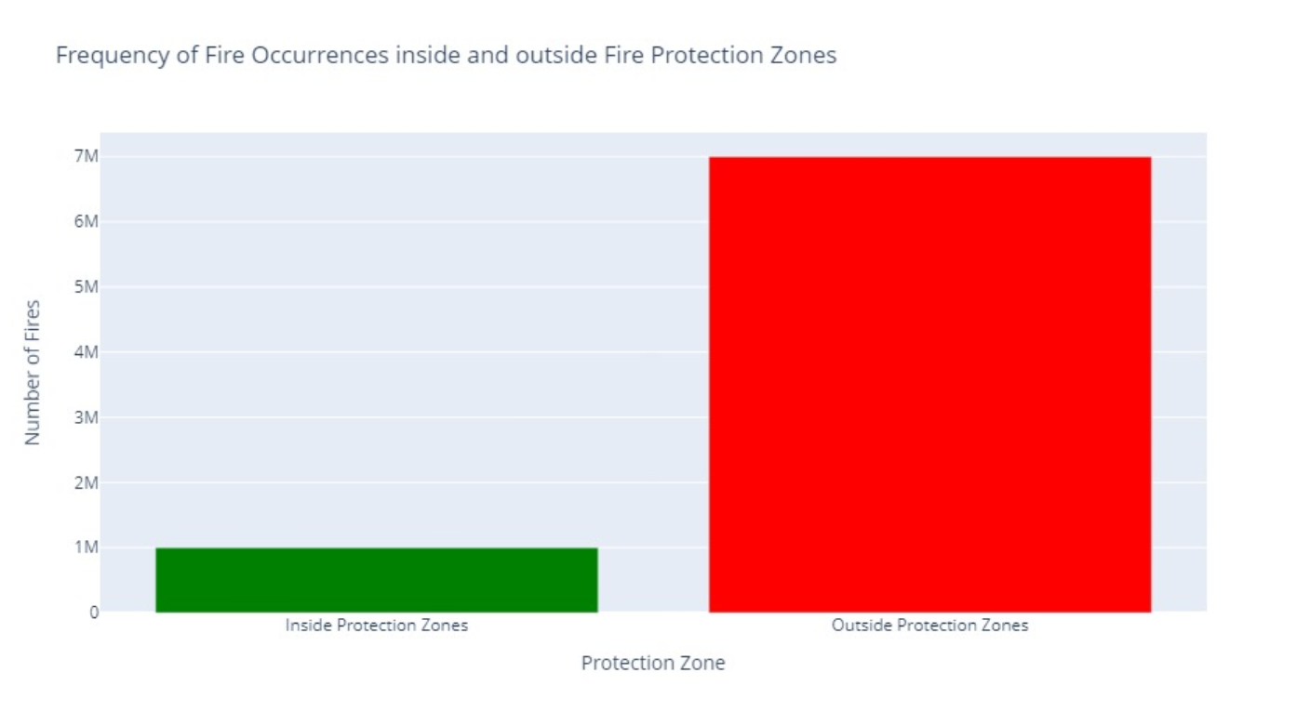
Fire Protection Zone effect on wildfires
Protection zones are strategically designed and implemented to create barriers or areas with reduced fuel loads that can help prevent or slow the progression of wildfires.

Slide 11
LIVE PRESENTATION

